Slide 1
B-Prime Direct
B is for Brilliant

Slide 2
B-Prime Direct
A modern B-vitamin complex in highly bioavailable forms for effective replenishment and cellular energy support.

Slide 3
B Vitamins help maintain balance in the body
B1
B2
For nervous system function and carbohydrate metabolism
For energy metabolism and antioxidant support
B3
B4
For skin health and energy metabolism
For brain function and cell membrane health
B5
B6
For energy metabolism and skin health
For protein metabolism and nervous system function

Slide 4
B Vitamins help maintain balance in the body
B7
B8
For healthy hair, nails, and skin
For nerve impulse transmission and emotional well-being
B9
B12
For immune function, supporting cell renewal and growth processes
For energy production and immune function

Slide 5
The body obtains B vitamins from food, but due to external factors, they are not always in sufficient amounts.
Alcohol--reduces the absorption of B vitamins and Vitamin C and increases their loss through urine, contributing to their depletion in the body.
Industrial grain processing — removes a significant portion of vitamins from food.
Heat treatment and prolonged storage in light — also leads to vitamin loss.
Foods high in simple carbohydrates (baked goods, fast foods, sweets)--increase the body's need for B vitamins to metabolize sugar

Slide 6
Signs of inadequate B vitamin intake
may not be immediately noticed. Here are some signs to watch out for:
Lack of energy and trouble sleeping
Slow skin regeneration and changes in skin health
Irritability and occasional anxiety
May affect immune function
Dry skin and mucous membranes
May affect hair health and nail strength

Slide 7
Groups Most at Risk for Inadequate B Vitamin Intake:
The elderly;
Those with GI tract issues;
Those using certain medications (e.g., oral contraceptives, including combination oral contraceptives)
Individuals under high levels of physical or mental stress;
Those with metabolic conditions (e.g., diabetes);
Individuals with lifestyle factors (e.g., smoking)

Slide 8
Vegetarians & Vegans
may be at risk for inadequate vitamin B intake.
For those who do not consume enough animal products, it is especially important to monitor vitamin B12 levels, as it is mostly found in animal-based foods and not naturally in plant-based foods. Dietary supplements can help maintain adequate B vitamin levels.

Slide 9
B-Prime Direct
10 B vitamins in a modern, bioavailable form
These statements have not been evaluated by the Food and Drug Administration. This product is not intended to diagnose, prevent, treat, cure, or prevent any disease.

Slide 10
One serving of B-Prime Direct contains:
B1
B2
Thiamine Hydrochloride
Riboflavin 5-Phosphate**
5 mg — 357 %*
6 mg — 375 %*
active form**
B3
B4
Nicotinamide
Choline Citrate
30 mg — 167 %*
100 mg — 20 %*
(Active form), Does not typically cause skin irritation.
B5
Calcium D-Pantothenate
10 mg — 167 %*
*Percentage of the recommended daily intake **Supports the body's use of vitamin B2 for normal energy metabolism.

Slide 11
One serving of B-Prime Direct contains:
B6
B7
Pyridoxal 5-Phosphate
D-Biotin
150 mcg — 300 %*
3,5 mg — 175 %*
active form
active form
B8
B9
Myo-Inositol
Calcium Methylfolate (Methyltetrahydrofolate)
75 mg — 15 %*
Patented active form Extrafolate-S™**
200 mcg — 100 %*
B12
Methylcobalamin
9 mcg — 900 %*
active form
*Percentage of the recommended daily intake **Formulated for optimal absorption and use

Slide 12
One Serving of B-Prime Direct =
Parsley
Corn
200 g
350 g
Semi-hard cheese
Sunflower seeds
630 g
1 kg
Turkey liver
Anchovies
200 g
170 g
Beans
1,07 kg

Slide 13
Patented form of the Vitamin B9 ExtraFolate-S™:
Formulated for optimal absorption and support
Immediately utilized by the body, whereas regular folic acid requires prior conversion.
Does not mask vitamin B12 deficiency, which can occur with high doses of folic acid.
from the French company Gnosis by Lesaffre

Slide 14
B-Prime Direct
Supports sustained energy levels and focus
Enhances cognitive function and memory
Contributes to mood balance
Helps the body cope with occasional stress
Promotes healthy skin, hair, and nails

Slide 15
The Coral Club lineup now includes a new product format: powder sticks that dissolve in the mouth.

Slide 16
Quickly absorbed
The product is designed to be absorbed through the oral mucosa for convenient and efficient use.
Convenient to use
The product does not need to be taken with water or dissolved; it is also easier to swallow compared to tablets.
Easy to take with you
The compact stick is always on hand for your active day.

Slide 17
How to use B-Prime Direct
1 stick pack a day in the morning after breakfast. Pour directly into your mouth without water
Take the stick pack out of the box.
Open along the indicated line.
Pour the entire contents of the pack into your mouth and onto your tongue.
Allow the powder to dissolve on your tongue before swallowing. Do not drink with water.

Slide 18
B-Prime Direct —energize your day!
Support your energy levels during times of physical or mental stress
Ideal for use before or after exercise

Slide 19
B-Prime Direct —supports sustained energy and focus
Before a night out
While traveling

Slide 20
Compatible Product Combos
B-Prime + Coral Lecithin
B vitamins work synergistically with lecithin, supporting the nervous system. Combined use of these products aids cognitive function * and helps the body manage occasional stress.

Slide 21
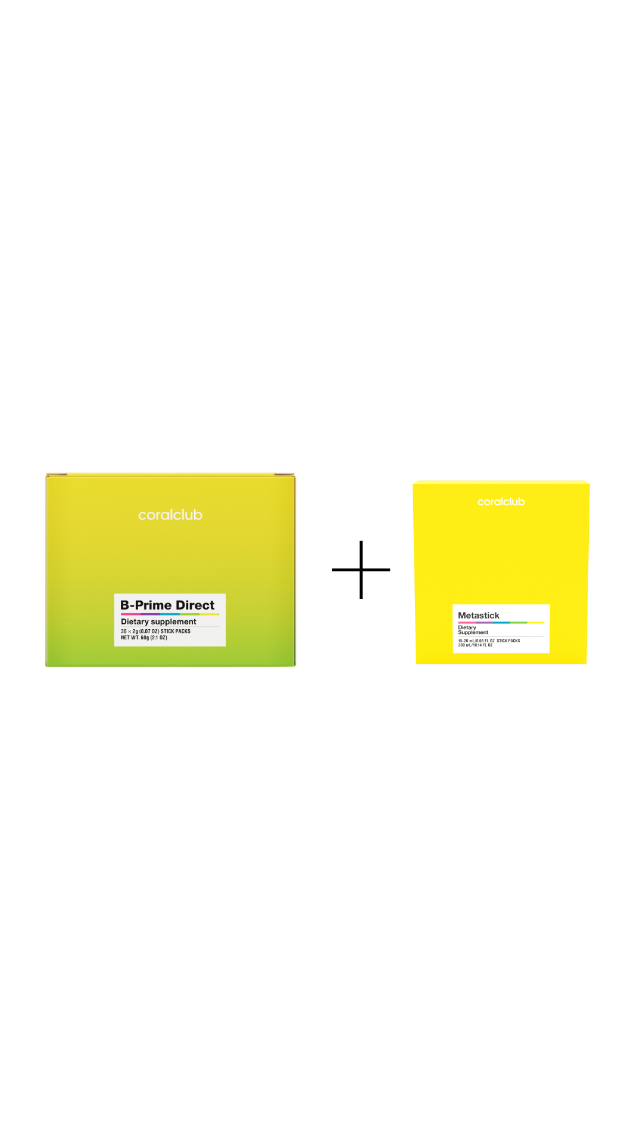
The Perfect Combo to Support Microflora
B-Prime + Metastick
The combination of B vitamins and beneficial bacteria enhances microbiota balance. Pro-, pre-, and postbiotics contribute to the synthesis of vitamins B2, B6, B9, and B12*, which, in turn, support optimal metabolism* and strengthen intestinal barrier function.

Slide 22
B Vitamins make Nutripack even better:
Support carbohydrate and fat metabolism
Help the body recover after physical and mental exertion
Support sustained energy levels

Slide 23
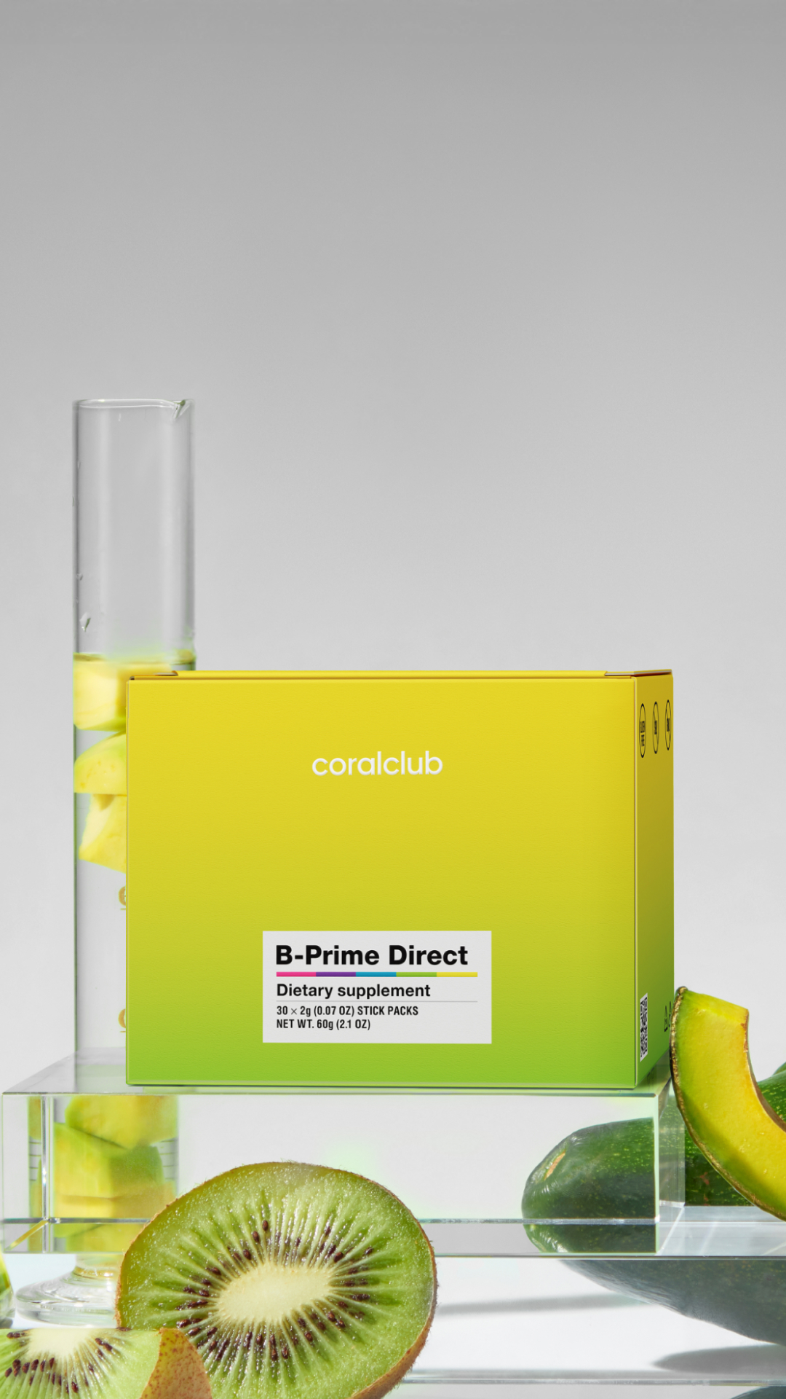
B-Prime Direct
Energize your day with every pack

