Slide 1
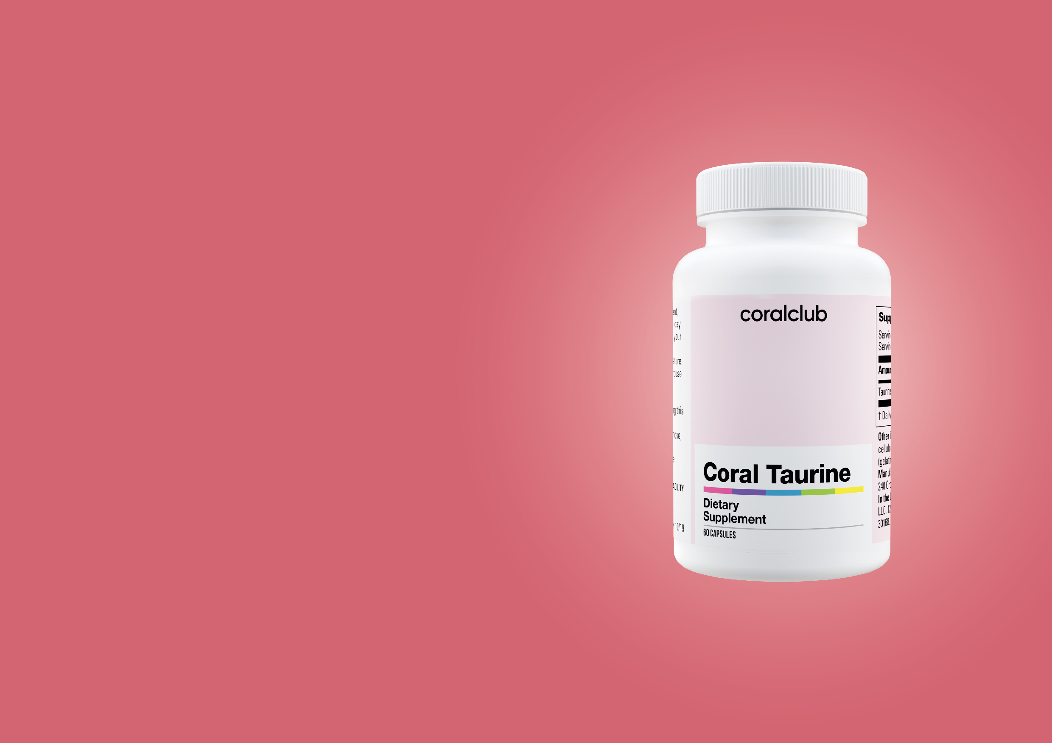

Coral
Taurine
Life Energy
Notes:
Taurine is an amino acid that was first isolated by Tiedemann and Gmelin (Germany) in 1827 from the bile of oxen. It received its name from the Greek word "taurus," which means "bull." The discovery of taurine had no particular significance until 1970 when scientists found its indispensable role as a dietary element for cats. Without it, animals developed blindness and experienced serious heart problems.
The recognition of its importance for the body lies in the fact that taurine is considered a conditionally essential amino acid, even though, unlike other amino acids, it does not participate in protein synthesis.
1

Slide 2
“If all medical professionals recognized or understood the value of taurine, it would always be among the top three most popular dietary supplements.“
Dr. Atkins
Notes:
2

Slide 3


Let me to introduce myself, I am Taurine!
Notes:
Taurine is a conditionally essential amino acid with high biological activity, crucial for the normal functioning of the body.
Taurine is a cytoprotector, which literally means "cell protector." This is its most important and primary function.
It manages the operation of cellular membranes and safeguards and stabilizes them by regulating the transport of nutrients and electrolytes across the membranes. For example, in the heart, it plays a significant role in the movement of calcium ions through the membranes: depending on the needs, it can increase or decrease calcium levels, retain potassium and magnesium inside the cell, and sodium outside.
Taurine plays a critical role in regulating the conduction or inhibition of nerve impulses in the central nervous system (neurotransmitter or neuromodulator).
Taurine is a component of the primary bile component, tauroursodeoxycholic acid.
Taurine also possesses antioxidant properties.
3

Slide 4
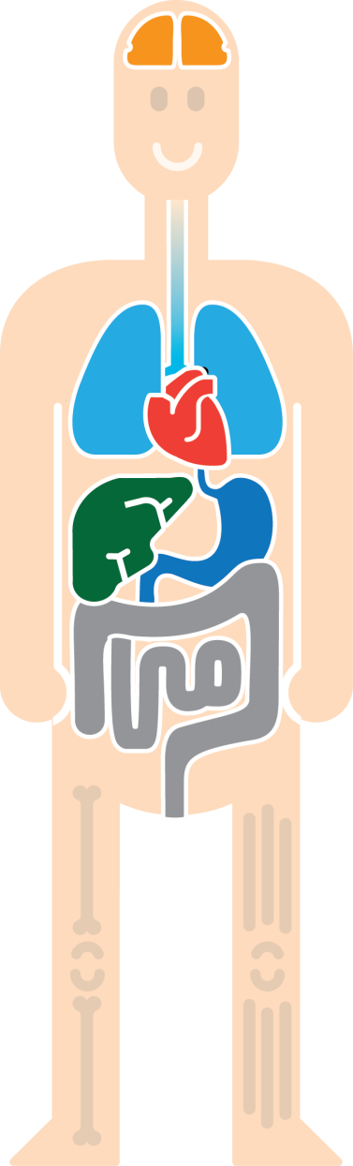
Presence in the Body
Brain
Blood vessels
Eyes
Kidneys
Heart
Skeletal muscles
Notes:
Taurine is present in virtually all vital organs and tissues from conception to deep old age. In developing brain tissue, it is found in very high concentrations. Children's brains contain four times as much taurine as adults. Taurine is the primary amino acid present in the retina of the eye (40-50%). In the cardiac muscle, it also accounts for over 50% of taurine. Taurine is a component of the primary constituents of bile. It is abundant in lymphocytes, leukocytes, and platelets - white blood cells that perform protective functions in the body.
4

Slide 5
The Role of Taurine
Improves blood circulation and metabolic processes in the cardiac muscle
Reduces the formation of "bad" cholesterol in the blood
Protects healthy cells from free radicals
Supports the necessary levels of vitamins C, E, and the protective protein glutathione in the body
Is essential for the functioning
of the biliary system
Notes:
Several more facts about Taurine:
Improves brain function, enhances attention, and boosts memory.
Protects the eyes.
Strengthens bones and the circulatory system.
Enhances vitamin absorption.
Prevents the development of diabetes.
Breaks down fat cells.
Strengthens the immune system.
Removes excess fluid from the body.
Positively impacts a person's psychological health.
5

Slide 6
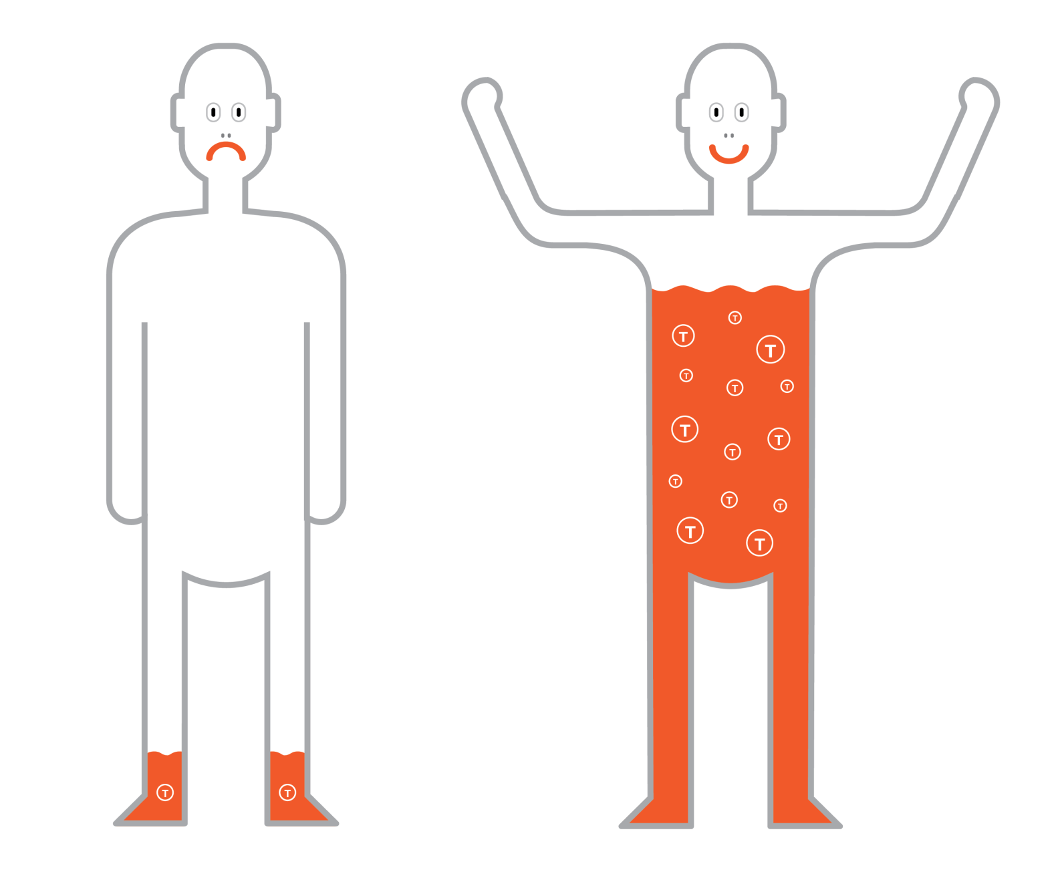
The Body's Need for Taurine
Notes:
In the body, Taurine can be synthesized from methionine and cysteine with the involvement of vitamin B6, but there are situations where there is excessive excretion of taurine from the body:
During periods of stress.
After exposure to radiation and chemotherapy.
Following surgical procedures.
During ischemic conditions and arrhythmias.
In cases of intestinal diseases.
With alcohol and nicotine abuse.
In diabetes.
During hormonal replacement therapy with estrogens.
6

Slide 7


Taurine influences on:
Active growth and rapid development of a child
Protection of the heart during increased physical exertion
Notes:
Did you know that in the first four days after a baby's birth, the taurine content in the mother's milk significantly increases? The rapid growth and development of the infant put extra strain on their heart. Taurine is capable of supporting the body during this critical period.
The impact of taurine on improving athletic performance is still under study, but even now, scientists confidently state that heavy physical exertion affects the function of the heart. Taurine is intended to protect and maintain the healthy state of our "engine."
7

Slide 8




"Hidden" Taurine Deficiency
Heart failure
and arrhythmia
Weakening of vision
and the development of
eye diseases
Acute and chronic stresses,
memory impairment
Weakness of
skeletal muscles
Notes:
After the age of 40, the synthesis of taurine in the human body decreases. The concentration of taurine in the blood and plasma of elderly people decreases by almost half.
When the body lacks taurine, the processes it is responsible for will either occur weakly or not at all. Initially, the body's reserves will be used, followed by mild, inconspicuous disturbances at the cellular level, and then at the level of the whole body.
Adding taurine to one's diet can help avoid problems such as:
Heart failure.
Deterioration of vision and the development of eye diseases (cataracts).
Weakening of skeletal muscles.
Stress, memory impairment, sleep disorders.
Liver and pancreatic disorders (absorption of fats and sugars, excess cholesterol).
Development of atherosclerosis.
Weakened immunity.
8

Slide 9



Interesting Fact
=
=
- Caffeine >
- Taurine >
Other ingredients:
Melatonin
Fast-acting carbohydrates
B-complex vitamins
Matéine
Narrows blood vessels, raises blood pressure
Protects the heart
Notes:
Energy drinks are essential in situations where you need to stay alert and boost brain function, and rest is still far away.
So, what's the secret of energy drinks?
The contents of the can act as a key, unlocking the doors to the body's internal resources and opening up the body's own energy channels. In other words, the can doesn't give you energy; it extracts it from you. People use their own resources, essentially borrowing them. Of course, debt needs to be paid sooner or later, resulting in exhaustion, insomnia, nervous breakdowns, irritability, and depression.
The primary component of energy drinks is caffeine, and its excessive consumption raises certain concerns. With regular caffeine intake, the body becomes depleted. Excess caffeine leads to frequent urination and significant salt loss from the body. What's worse is that the body builds tolerance to caffeine over time, requiring higher doses.
Taurine, which is found in energy drinks, helps protect the heart, partially compensating for the aggressive effects of caffeine in the doses contained in these drinks. While caffeine narrows blood vessels and raises blood pressure, taurine stabilizes blood pressure by smoothing out pressure fluctuations. It does this by stabilizing cell membranes and regulating the movement of electrolytes (minerals) through cell membranes.
Note that significant amounts of caffeine are found in such common beverages as tea, coffee, and cola.
Do you and your loved ones consume them? Think about whether your body has enough taurine to protect your heart.
Another common "substance" is nicotine, which also narrows blood vessels and raises blood pressure. In 2003, scientists discovered that taking taurine by smokers led to the improvement of blood vessel conditions, bringing it closer to the state of non-smokers within two weeks.
9

Slide 10
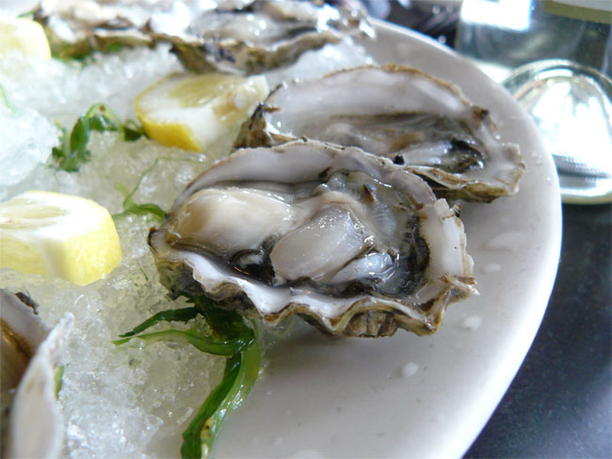
Where to find Taurine?
{
Taurine
Shrimps
Crabs
Crayfish
400 mg
daily requirement
Squid
Oysters
Mussels
Notes:
The recommended daily intake of taurine for humans is 400 mg.
Taurine is found in animal-based products and is virtually absent in plant-based foods. Among animals, it is best to consume invertebrate marine organisms (mollusks, squid, oysters, shrimp) as they contain a relatively significant amount of this substance.
10

Slide 11
OR

Slide 12
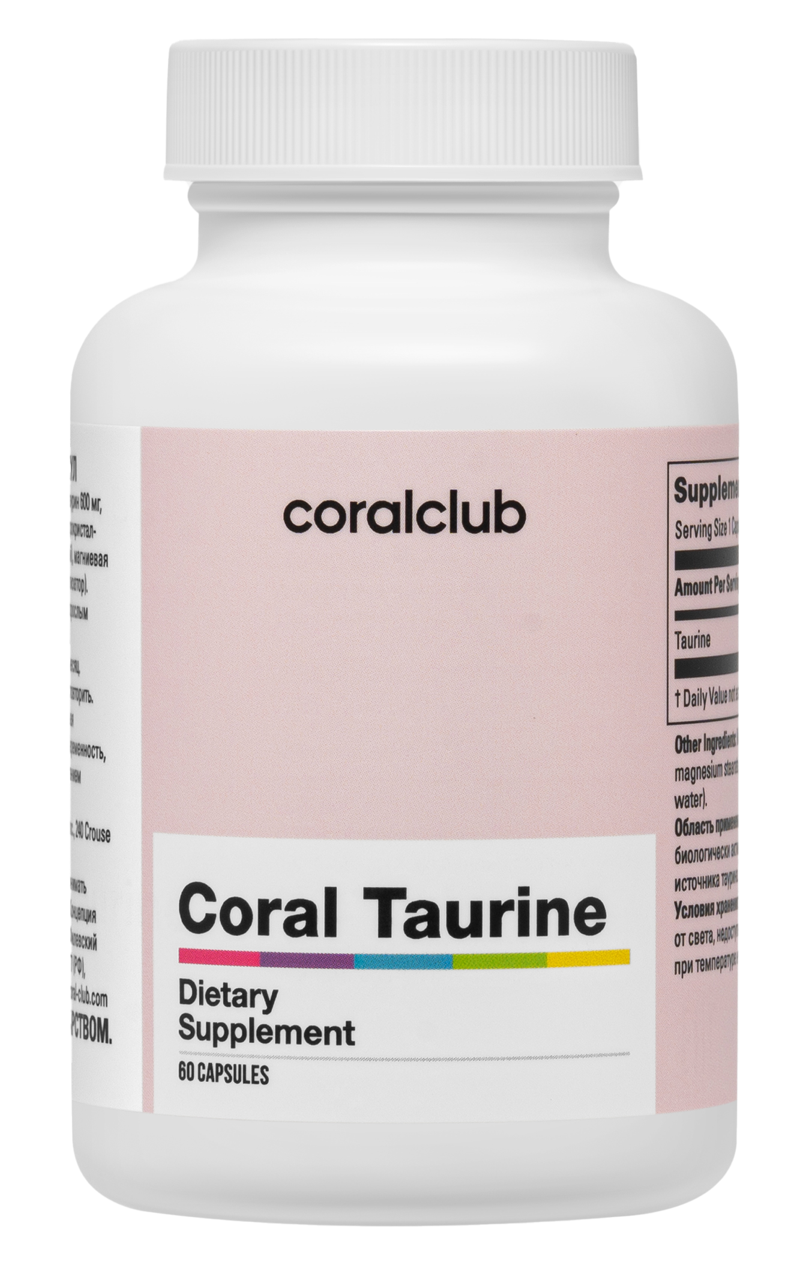
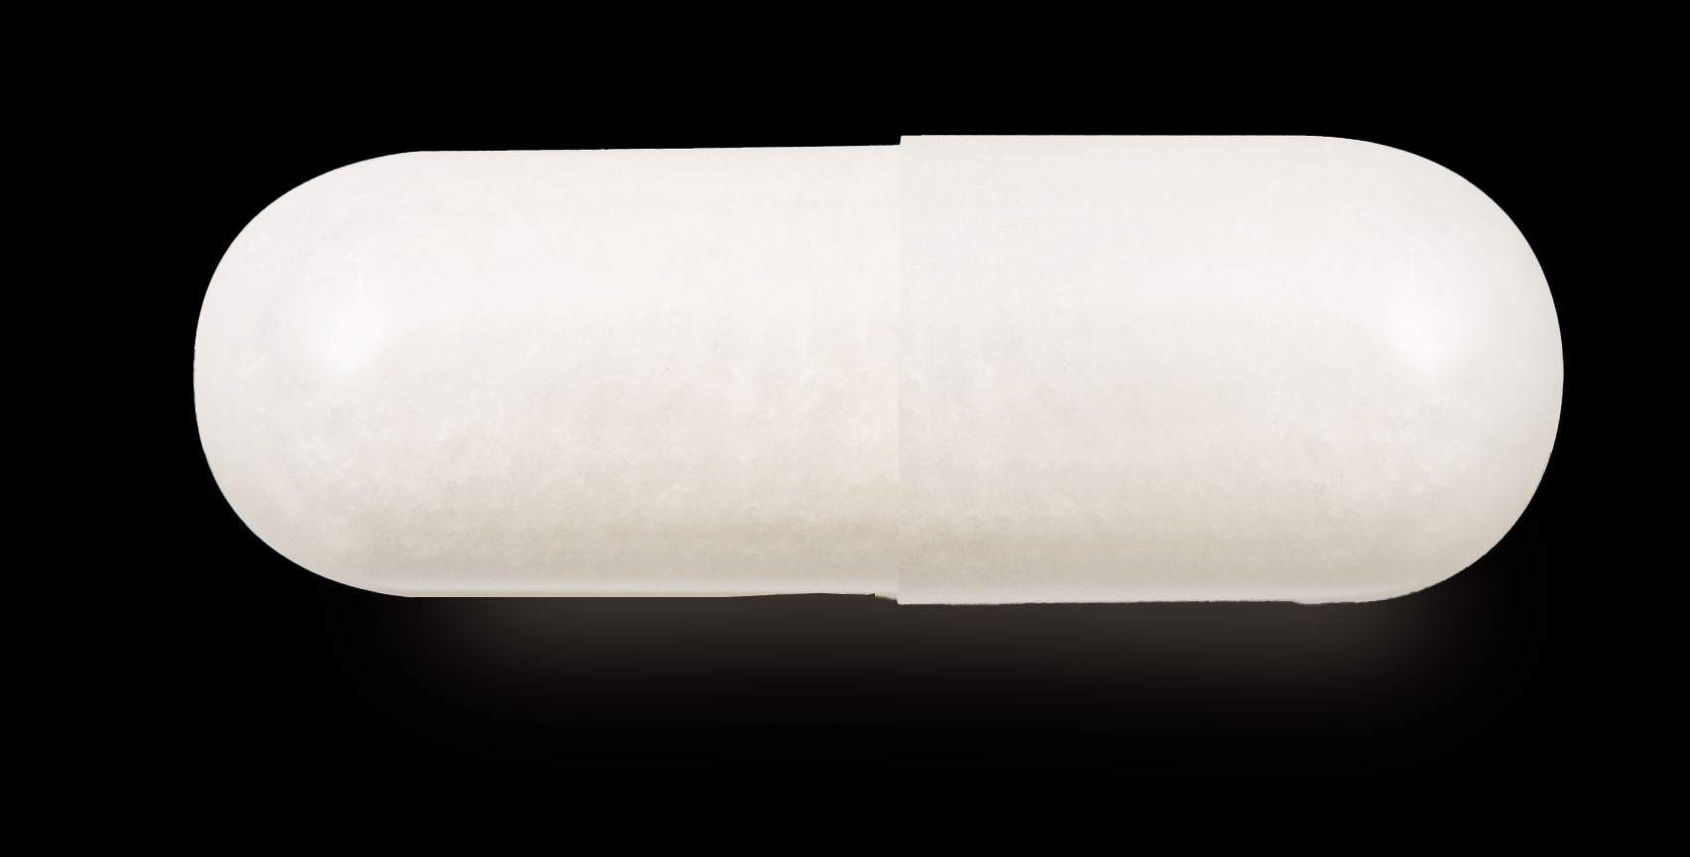
Notes:
Coral Taurine is a product that can help replenish taurine deficiency in the body.
Each capsule contains 600 mg of taurine, which is 150% of the recommended daily intake.
Coral Taurine is consumed as a dietary supplement and is a source of taurine.
Usage instructions:
Take 1 capsule daily with a meal.
Duration of use:
1 month.
If necessary, the course can be repeated.
Contraindications: Individual intolerance, pregnancy, breastfeeding. It is recommended to consult a doctor before use.
12

Slide 13
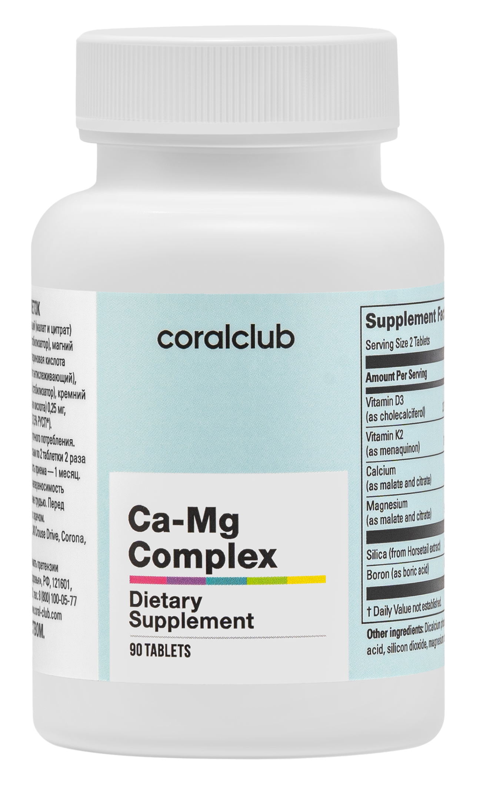
Calcium-Magnesium and Taurine
+
Notes:
It is recommended to consume taurine in combination with magnesium to maintain the optimal condition of the heart and blood vessels. Additionally, the use of taurine and magnesium in the required amounts significantly reduces the risk of depressive conditions.
13

Slide 14

Taurine is Beneficial for Everyone
Notes:
In preventive doses, taurine is entirely safe, and its therapeutic doses can be significantly higher, up to 3 grams per day. Correcting taurine deficiency in the body is also necessary because it cannot be replaced by another substance, as taurine is involved in many vital physiological and biochemical processes within the cell.
Taurine is needed by:
Vegetarians
Athletes
Elderly individuals
People with heart conditions
Those who spend extended hours at the computer or reading
Individuals who smoke and consume a lot of coffee or other stimulating drinks
Taurine is beneficial for everyone!
14

Slide 15
Notes:
Coral Taurine
Code 2101
Dosage form: 60 capsules.
Composition: taurine 600 mg
Auxiliary components: microcrystalline cellulose, magnesium stearate, capsule (gelatin, water).
15

